Slide 1


Maddila Devisree Sai
30th November 2025

Slide 2

Outline
Executive Summary
Introduction
Methodology
Results
Conclusion
Appendix

Slide 3
Executive Summary
This project analyzes SpaceX Falcon 9 launch records to understand the factors that influence successful booster landings.
Historical launch data was acquired using API requests and web scraping and then cleaned for analytical consistency.
Interactive visualizations were developed using Folium and Plotly Dash to explore launch patterns and success rates.
Machine learning models were implemented to predict landing outcomes based on key flight attributes and payload characteristics.
The study provides insights that support SpaceX’s vision of reducing launch costs through booster reusability.

Slide 4
Introduction
Falcon 9 rockets are designed for partial reusability to significantly reduce the cost of space missions.
Booster landing success is a critical factor that determines reusability and operational efficiency.
Understanding the relationship between launch parameters and landing outcomes enables data-driven decision-making.
This project investigates launch sites, orbit types, payload ranges, and booster configurations that lead to successful booster landings.

Slide 5

Section 1

Slide 6
Methodology
Executive Summary
Data collection methodology:
Describe how data was collected
Perform data wrangling
Describe how data was processed
Perform exploratory data analysis (EDA) using visualization and SQL
Perform interactive visual analytics using Folium and Plotly Dash
Perform predictive analysis using classification models
How to build, tune, evaluate classification models

Slide 7
Data Collection
SpaceX Launch Data was collected using:
SpaceX REST API for structured launch records (launch site, payload, booster version, success outcome)
Web Scraping with BeautifulSoup to extract additional details such as landing pad and mission information
JSON and HTML responses were parsed and converted into pandas DataFrames
Intermediate datasets were exported as CSV files for use in subsequent labs

Slide 8
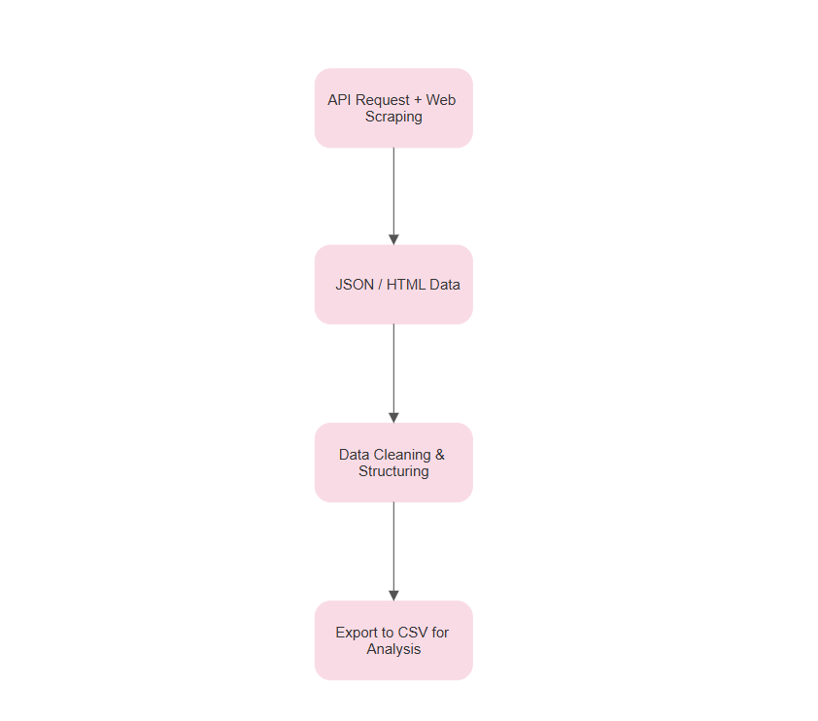
Data Collection – SpaceX API
Launch history was gathered from the SpaceX REST API, providing launch outcomes, payload data, flight number, booster version, and launch sites.
Web scraping (BeautifulSoup) was used to supplement API data with landing pad details and mission information not directly included in the API.
Retrieved JSON and HTML content was parsed and converted into pandas DataFrames.
Final processed datasets were exported as CSV files for use in later analysis and modeling

Slide 9
Data Wrangling
Removed unused or irrelevant features and standardized column naming for consistency.
Treated missing values by eliminating incomplete records or imputing values where appropriate.
Created a new “class” column indicating landing success (1) or failure (0).
Performed One-Hot Encoding on categorical features such as Launch Site, Orbit, Landing Pad, and Serial.
Exported the cleaned DataFrame as dataset_part_1.csv for future EDA and modeling.

Slide 10
EDA with Data Visualization
Visualized the relationship between Flight Number and Landing Success to study improvements over time due to engineering advancements.
Created plots of Payload Mass vs Launch Success to analyze how heavier missions affect booster recovery rates.
Compared success rates across different launch sites to identify the most reliable locations.
Examined the influence of Orbit type on landing outcome to understand mission complexity effects.
Used bar charts, scatter plots, and boxplots as they provide clear trends and enable comparison across mission attributes.

Slide 11
EDA with SQL
Queried the dataset to count total successful launches.
Calculated success rates per launch site to identify high-performing locations.
Analyzed success outcomes by orbit type to study mission category effects.
Retrieved launches with the maximum and minimum payloads.
Filtered missions using specific success conditions and payload ranges.
Joined tables to extract detailed relationships among flight parameters.

Slide 12
Build an Interactive Map with Folium
Plotted launch site markers to indicate the geographical position of each Falcon 9 launch location.
Added popup labels with launch site names to provide quick on-map context.
Used circle overlays to visually highlight the launch facility area and emphasize location significance.
Placed color-coded markers for successful and failed launches to distinguish mission outcomes spatially.
Drew distance lines between launch sites and their nearest coastline points to analyze logistic and safety constraints.
Applied interactive zooming and panning to explore launch geography dynamically

Slide 13
Build a Dashboard with Plotly Dash
Added a Launch Site dropdown to allow users to filter data and compare success performance across different sites.
Included a success pie chart
Displays overall successful launches when “All Sites” is selected
Shows Success vs Failure distribution for a specific site when selected
Implemented a Payload Range Slider to dynamically filter missions by payload mass.
Added a Payload vs Success scatter plot
Highlights how launch success varies across different payload values and booster versions
Color-coded points for visual clarity of booster categories
Enabled real-time dashboard updates so users can interactively explore how launch conditions impact landing outcomes.

Slide 14
Predictive Analysis (Classification)
Selected relevant input features (launch site, orbit, payload mass, booster version, etc.) from the one-hot–encoded dataset.
Split the data into training and test sets to objectively evaluate model performance.
Trained multiple classification algorithms such as Logistic Regression, Support Vector Machine, K-Nearest Neighbors, and Decision Tree.
Tuned model hyperparameters (e.g., C, kernel, max_depth, n_neighbors) to improve prediction accuracy.
Evaluated each model using accuracy score and inspected confusion matrices to understand types of errors.
Identified the best-performing model based on highest accuracy on the test set and used it for final landing success prediction.

Slide 15
Results
Exploratory Data Analysis
KSC LC-39A and CCAFS SLC-40 show the highest booster landing success rates.
Higher success probability observed for medium payload ranges rather than extremely heavy payloads.
Certain orbits such as LEO demonstrate more consistent landing outcomes
Interactive Visual Analytics
Folium maps reveal spatial clustering of successful launches near the U.S. East Coast.
Dash dashboard confirms launch site and payload are key factors affecting success.
Predictive Analysis
Among all models tested, the best classifier achieved high predictive accuracy for landing outcome.
Performance metrics show that reusable boosters can be predicted reliably using mission parameters.

Slide 16

Section 2

Slide 17
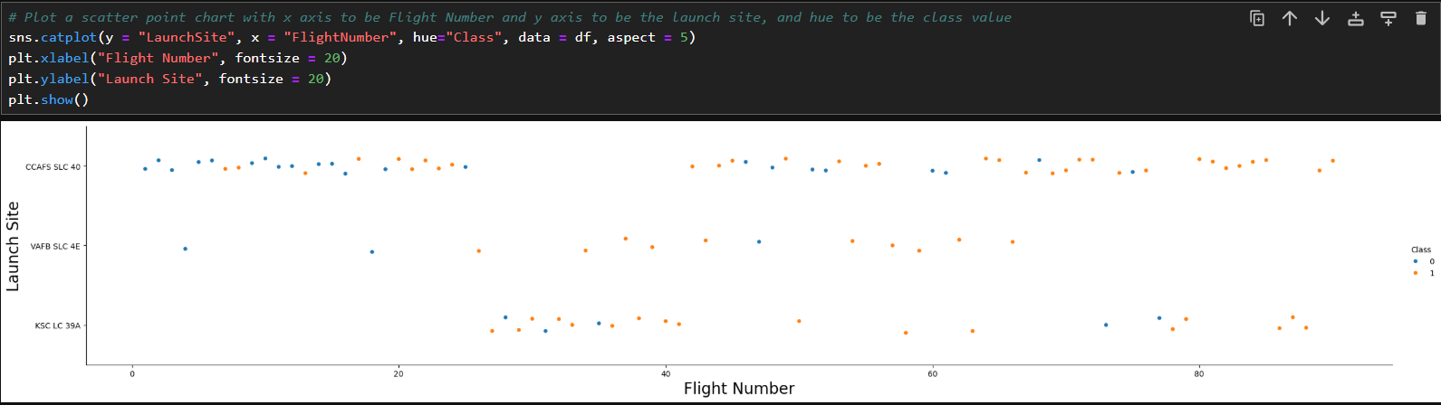
Flight Number vs. Launch Site

Slide 18
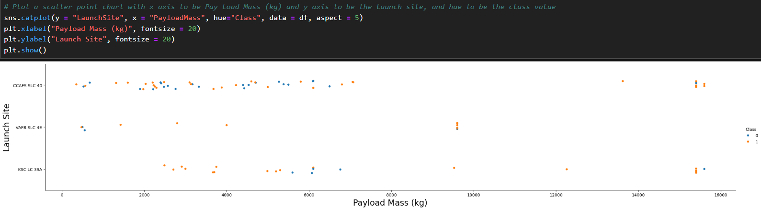
Payload vs. Launch Site

Slide 19
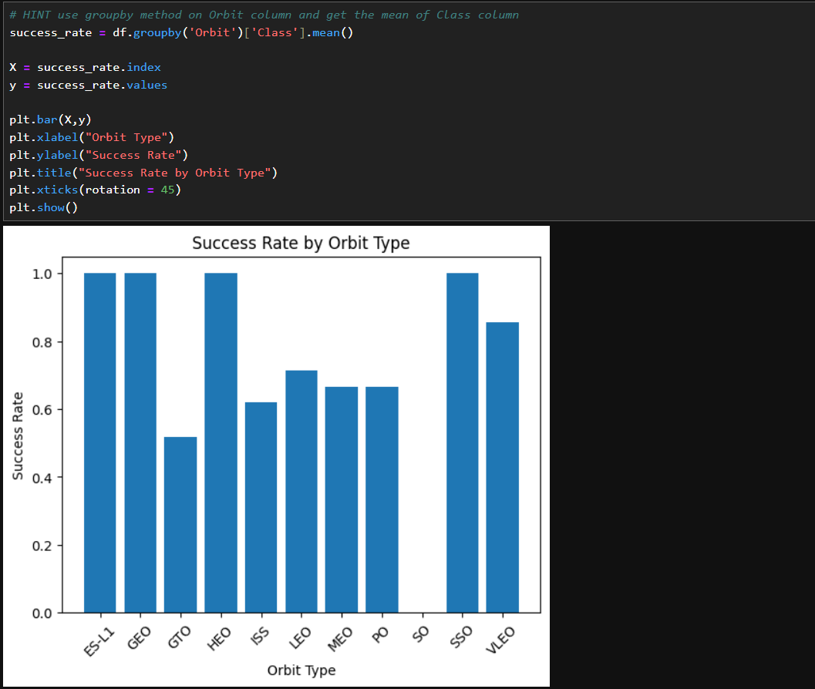
Success Rate vs. Orbit Type

Slide 20
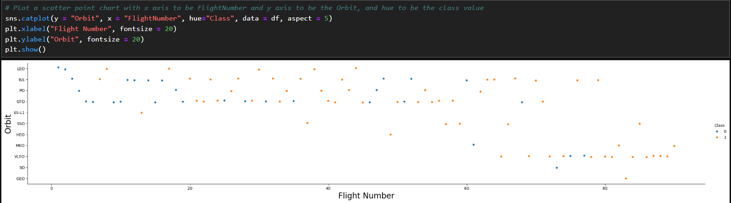
Flight Number vs. Orbit Type

Slide 21
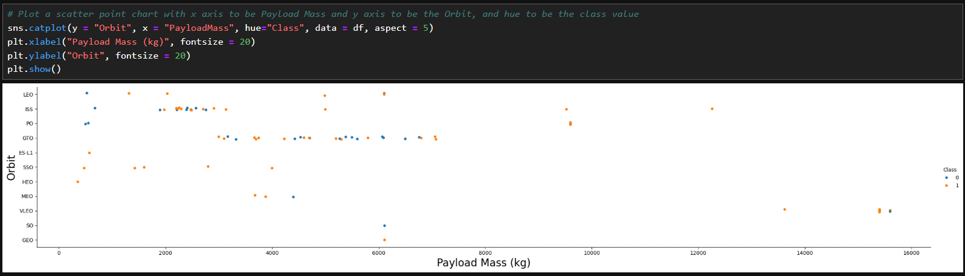
Payload vs. Orbit Type

Slide 22
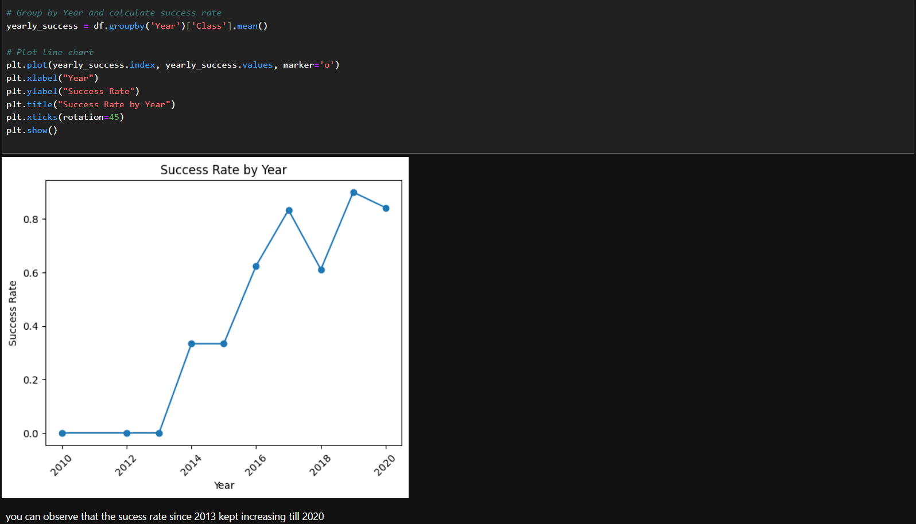
Launch Success Yearly Trend

Slide 23
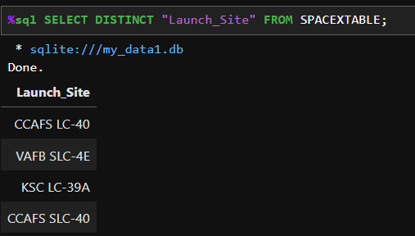
All Launch Site Names

Slide 24
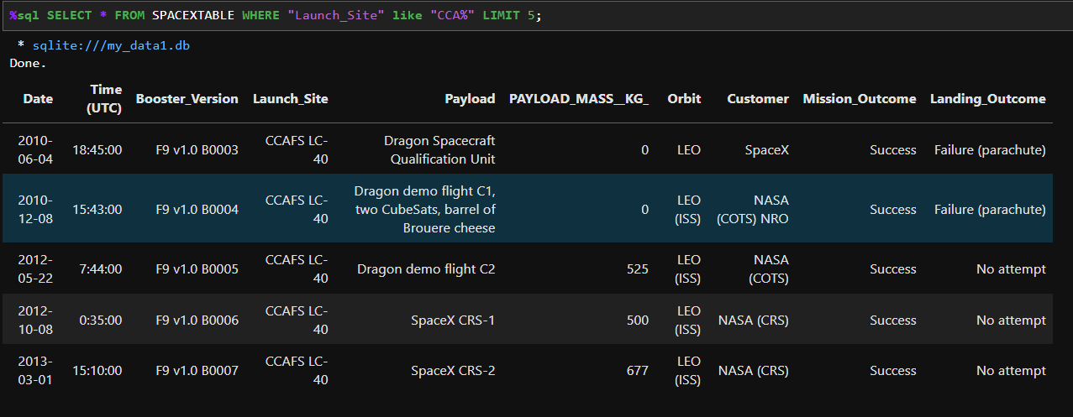
Launch Site Names Begin with 'CCA'

Slide 25
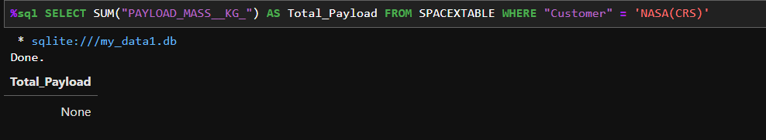
Total Payload Mass

Slide 26
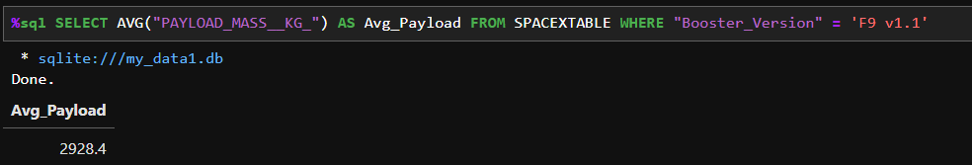
Average Payload Mass by F9 v1.1

Slide 27
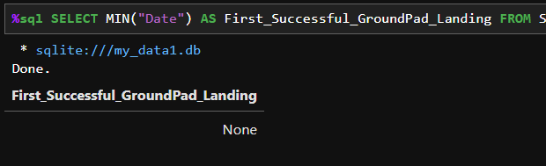
First Successful Ground Landing Date

Slide 28
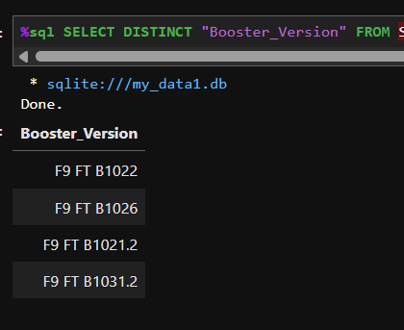
Successful Drone Ship Landing with Payload between 4000 and 6000

Slide 29
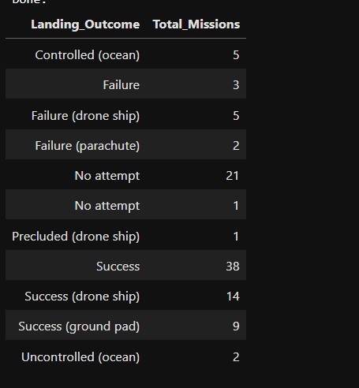
Total Number of Successful and Failure Mission Outcomes

Slide 30
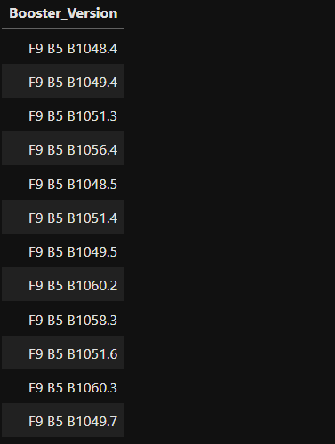
Boosters Carried Maximum Payload

Slide 31
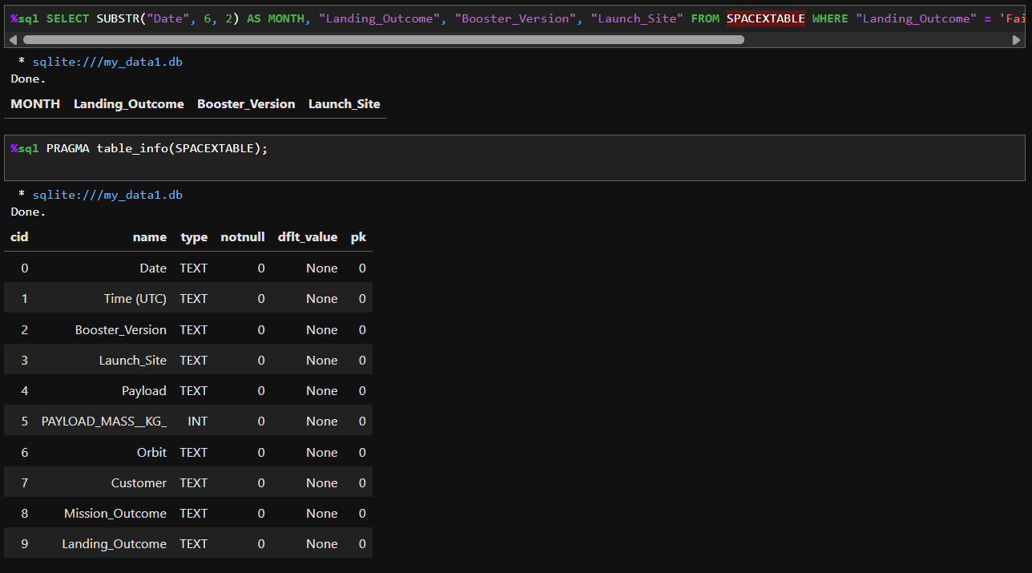
2015 Launch Records

Slide 32
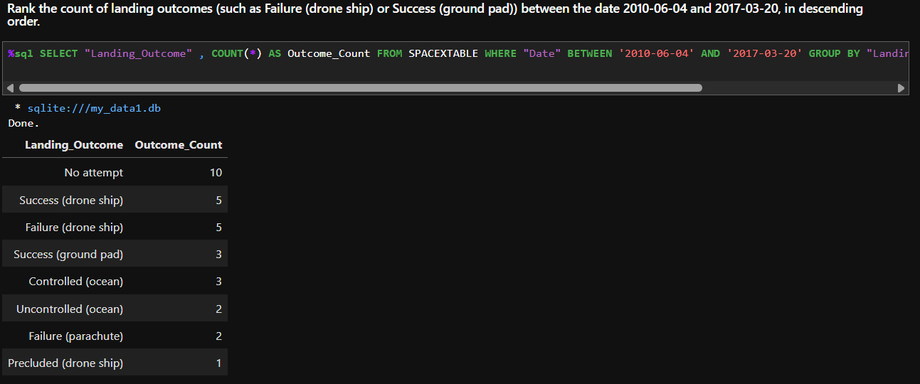
Rank Landing Outcomes Between 2010-06-04 and 2017-03-20

Slide 33

Section 3

Slide 34
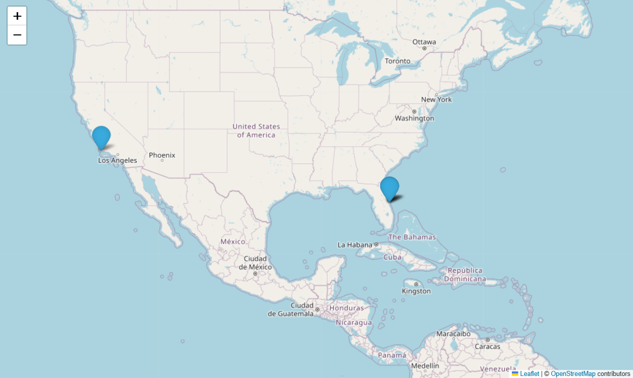
Launch Sites on Map

Slide 35
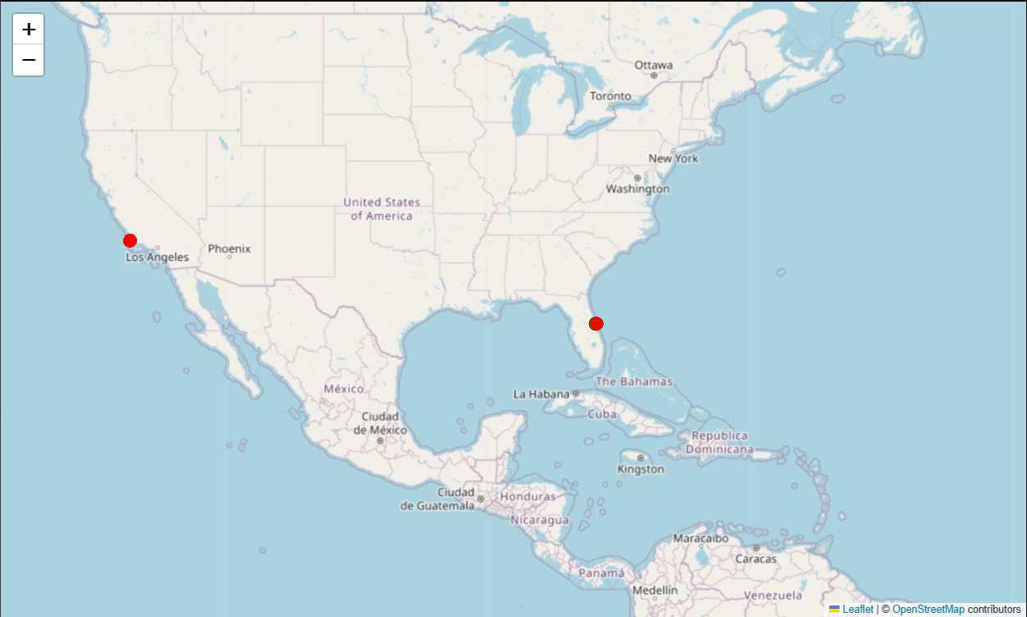
Success/Failed launches for each site on the map

Slide 36
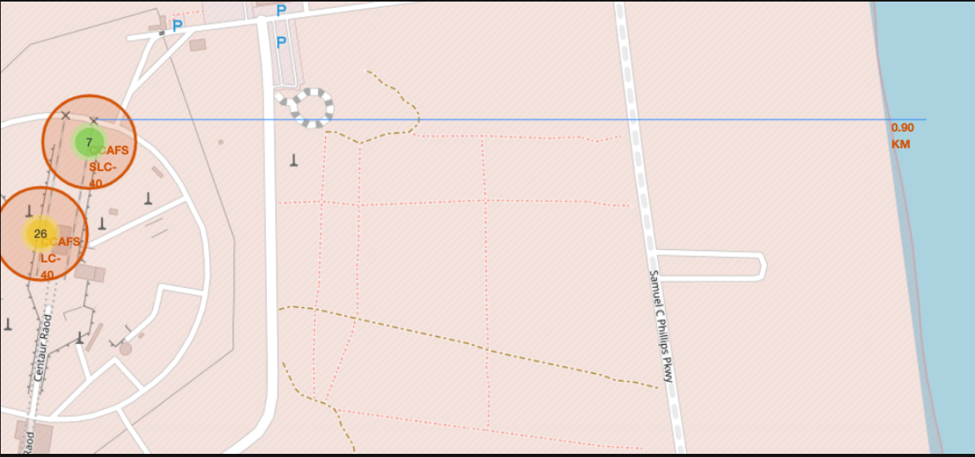
Distances between a Launch site to its Proximities

Slide 37

Section 4

Slide 38
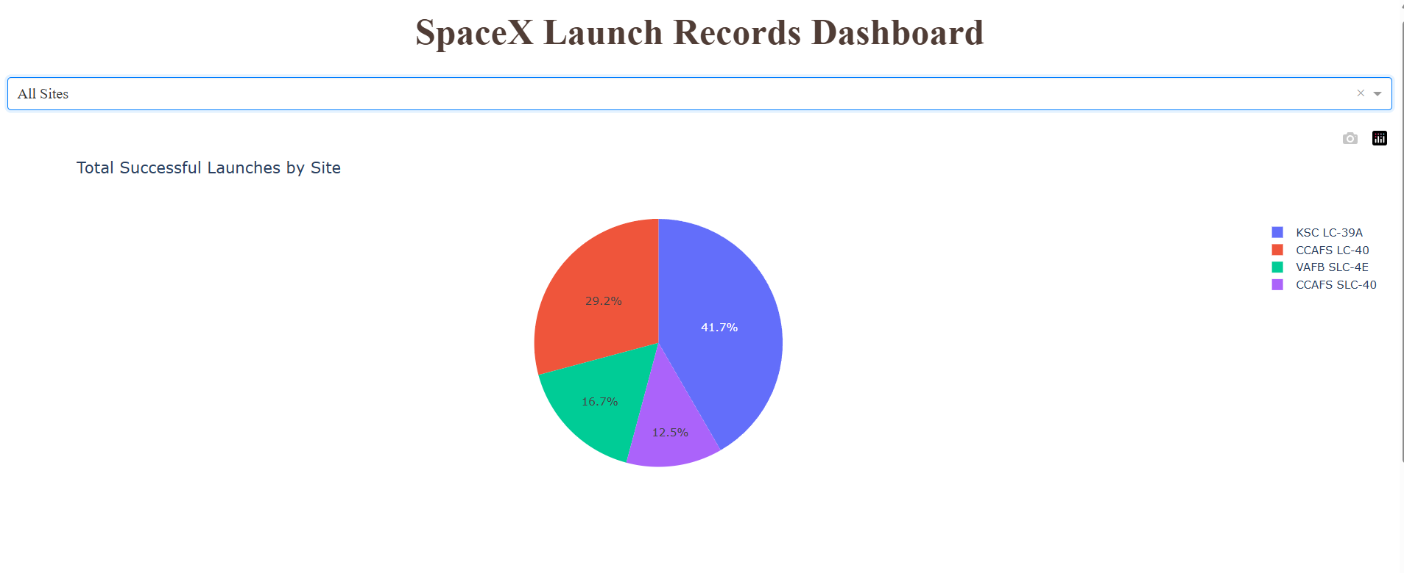
Total Successful Launches by Sites

Slide 39
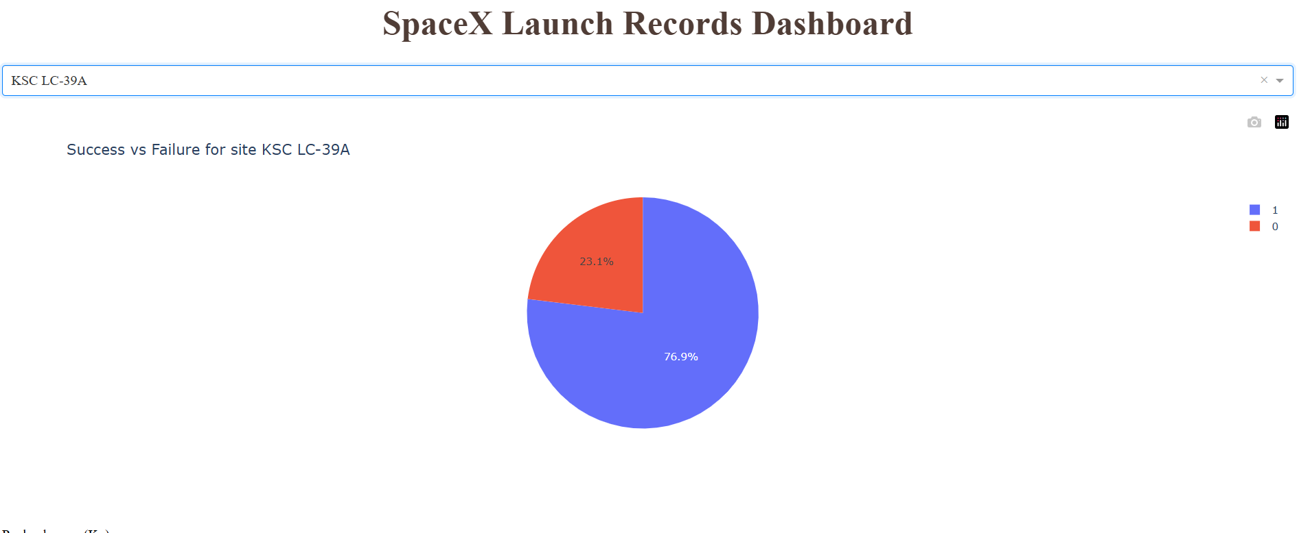
Booster with the Highest Success Ratio

Slide 40
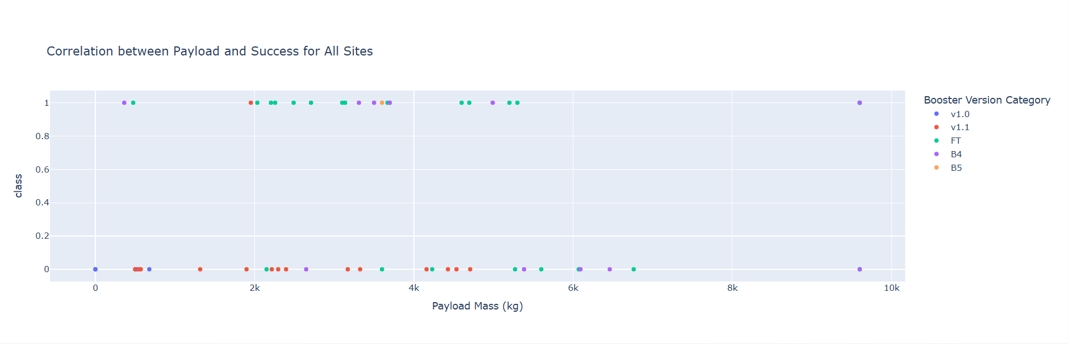
Scatter Plot for Payload v/s Launch Site’s Success

Slide 41

Section 5

Slide 42
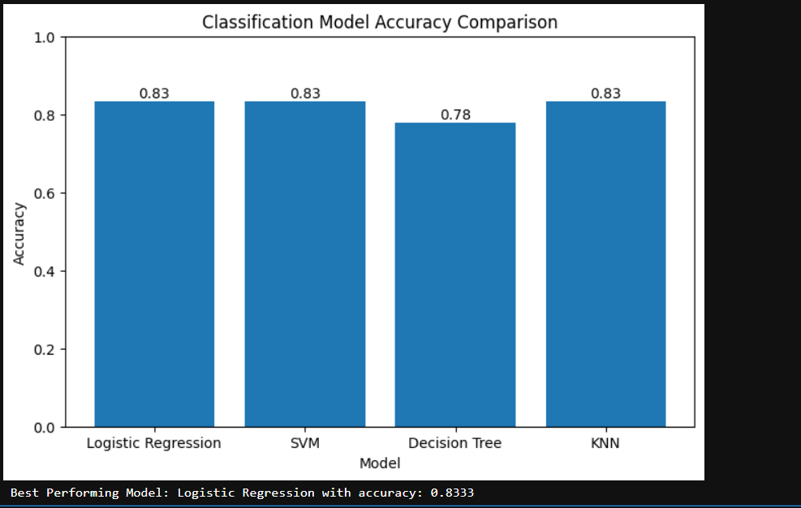
Classification Accuracy

Slide 43
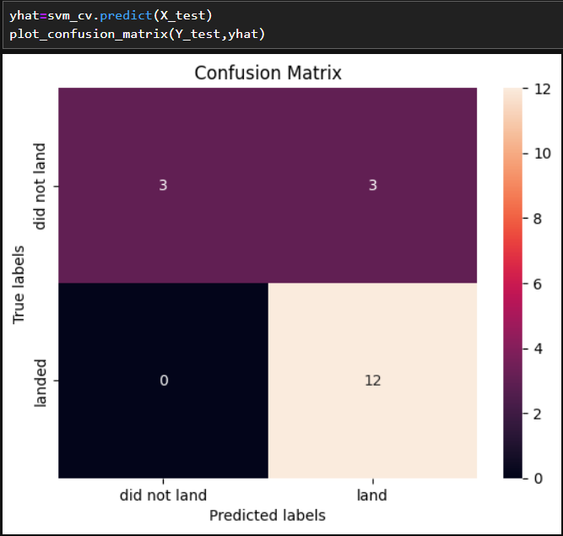
Confusion Matrix

Slide 44
Conclusions
Launch site and payload mass are strong predictors of Falcon 9 booster landing success.
Spatial and interactive analysis confirmed that KSC LC-39A and CCAFS SLC-40 deliver consistently higher success rates.
Classification modeling showed high predictive accuracy, demonstrating the feasibility of forecasting landing outcomes before launch.
These findings can help optimize mission planning and support SpaceX’s goal of reducing launch costs through booster reusability.

Slide 45
Appendix
Source Code & Notebooks
GitHub Repo : 🔗https://github.com/devi045/Capstone-DataScience-Project
Dataset Source
SpaceX REST API
Web scraped mission details from SpaceX official site
Development Tools
Python, Jupyter Notebook, pandas, NumPy
Folium, Plotly Dash
Scikit-learn
SQL
PyCharm (local execution
Environment Details
IBM Skills Network Labs
Local Python (Anaconda) when troubleshooting Dash visualization

Slide 46


